Slide 1
Generic zombie shooter
By Connor hadley

Slide 2
Concept
This will be a side on zombie shooter designed around the killing aspect of games rather than the storyline that most games aim towards in the modern era of gaming.
The idea is to give players a more simple playing experience rather than having to spend 2-3hours to setup for one mission, just jump in and get to blasting.
It is an endless shooter that players must complete waves within the time limit in order to advance, they must also not die during one of these waves.

Slide 3
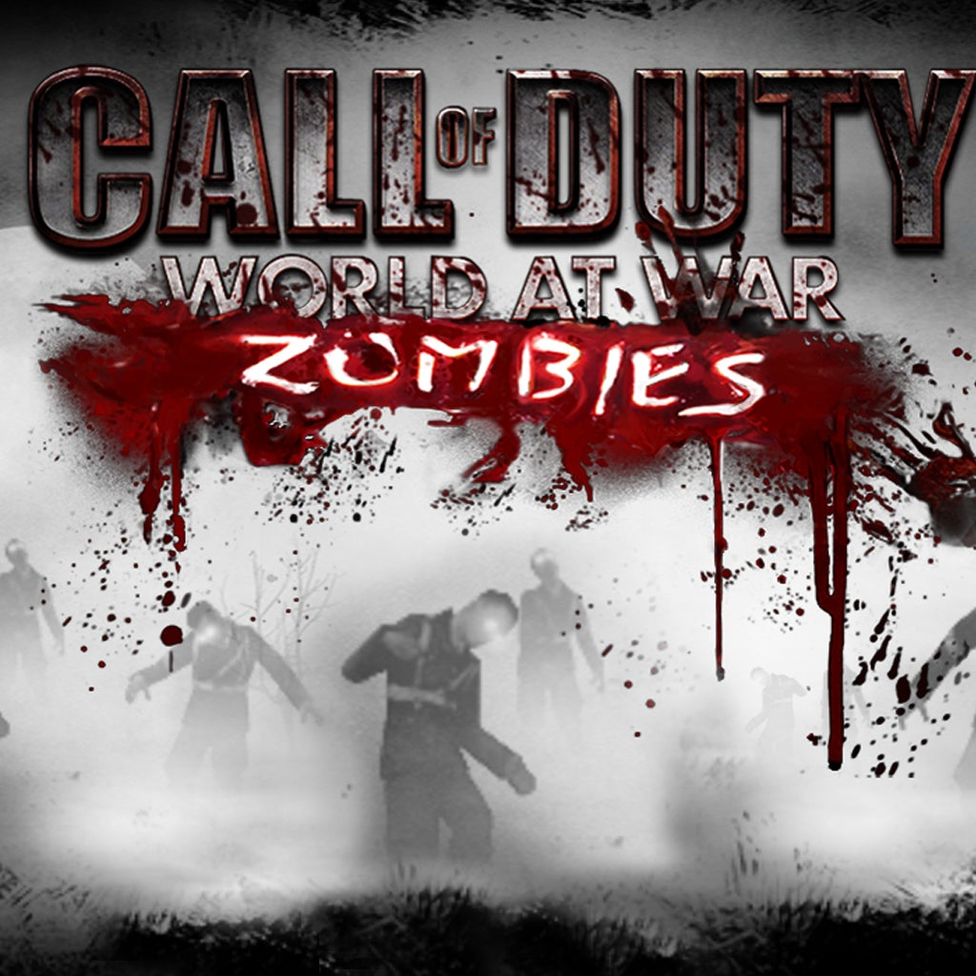
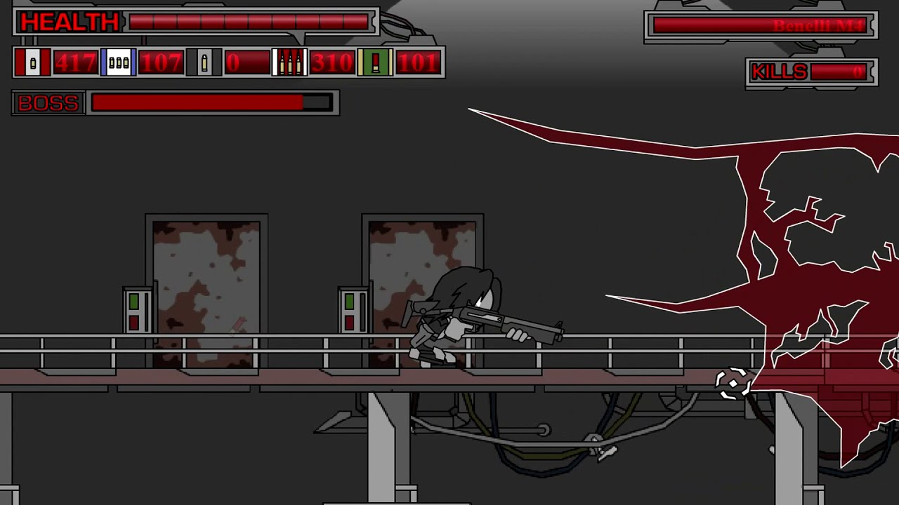
Inspired by
This idea was inspired by one of my favourite flash games of all time (Thing Thing) mixed in with call of duty zombies, one of my favourite game modes on console games.

Slide 4
genre
The genre will be an action-shooter game with action packed moments as the player will have little time after completing a round before the next one starts.
Research also dictates that action-shooters are the best selling games on average around the world.

Slide 5
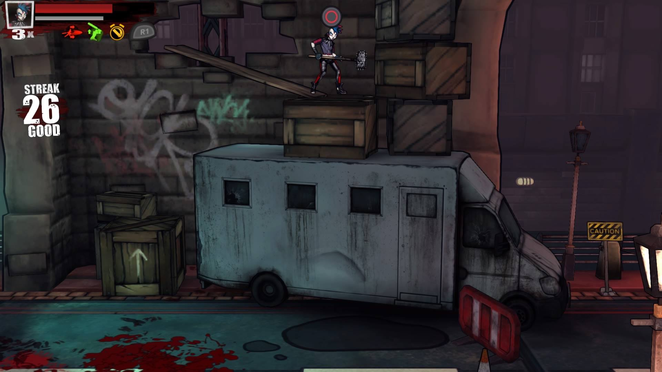
Theme
The themes and colouring will be dim/dark as the game is quite gory and morbid. Not only will the dark colours exaggerate the blood but will also provide atmosphere to the situation. Example below.

Slide 6
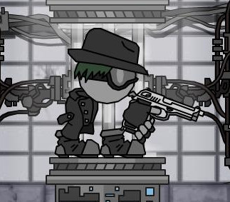
Characters
The player and enemies will be rather simplistic as it is a 2-D side scroller, a player model such as in thing thing would be very useable.

Slide 7
Environment
The scene for the game would be on the streets of a suburban town as I feel most people would be able to relate to this environment and would therefore make the game creepier.

Slide 8
Features
The player will have a kill count and a timer
Will be able to pick up power-ups
Can change guns that they earn throughout the game (potentially by reaching certain rounds.)
Infinite spawning of enemies

Slide 9
Effects
Blood splatter
Bullet collision
Sparkles after picking up powerups
Background lighting

Slide 10
Thank you for listening
If anyone has any questions feel free to ask

